Slide 1

CREDX RISK ANALYTICS CASE STUDY
BFS Capstone Project
Batch Jun-2018
By:
SHARATH ATHREY
SUMIT KAUSHIK
VANDHANA SHRI

Slide 2

Problem Statement:
CredX is a leading credit card provider that gets thousands of credit card applicants every year. But in the past few years, it has experienced an increase in credit loss. The best strategy to mitigate credit risk is to ‘acquire the right customers’.
Objective:
Identify the right customers
using predictive models.
Using past data of the bank’s
applicants, determine the factors
affecting credit risk.
Create strategies to mitigate the acquisition risk and assess the financial benefit of your project.

Slide 3

APPROACH TO SOLUTION
Business Understanding/Data Understanding
Data Preparation/EDA
Data Transformation/Model Building
Model Evaluation
Score Card Application

Slide 4

DATA UNDERSTANDING
Two Datasets provided namely,
Demographic Data:
Information provided by the
applicants at the time of
Credit card application.
Credit Bureau Data :
It provides all details of past
transaction taken from the
credit bureau.
DEMOGRAPHIC DATA | CREDIT BUEREAU DATA
Application ID | Application ID
Age | No of times 90/60/30 DPD or worse in last 6 months
Gender | No of times 90/60/30 DPD or worse in last 12 months
Income | No of Trades opened in last 6/12 Months
Marital status | No of PL Trades opened in last 6/12 Months
Education | Total Number of trades
Profession | No of Inquiries in last 6/12 Months (Excl Home/Auto Loans)
Number of dependants | Presence of open Home/Auto Loan
Number of Months in Curreny Company | Avg CC Utilzation in last 12 months
Number of Months in Curreny Residence | Outstanding Balance
Performance Tag | Performance Tag
TARGET VARIABLE with values:
0-Non-Default,1-Default

Slide 5

ASSESSING DATA QUALITY
OBSERVATIONS:
71295 rows in both datsets
Common Unique Variable - Application ID
Target variable -Performance Tag
3 Duplicate Application ID’s
Observed -Excluded from
further analysis
 | Variables | NA's Found | Others
 | Performance Tag | 1425 in both Datasets -excluded from further analysis
DEMOGRAPHIC | Age |  | 65 with Age <18- Capped to 18
 | Income |  | with Income <0-
 | Gender | 2
 | Marital Status | 6
 | No of dependents | 3
 | Education | 118
 | Profession | 13
 | Type of residence | 8
CREDIT | Avgas CC Utilization in last 12 months | 1058
 | No of trades opened in last 6 months | 1
 | Presence of open home loan | 272
 | Outstanding Balance | 272

Slide 6
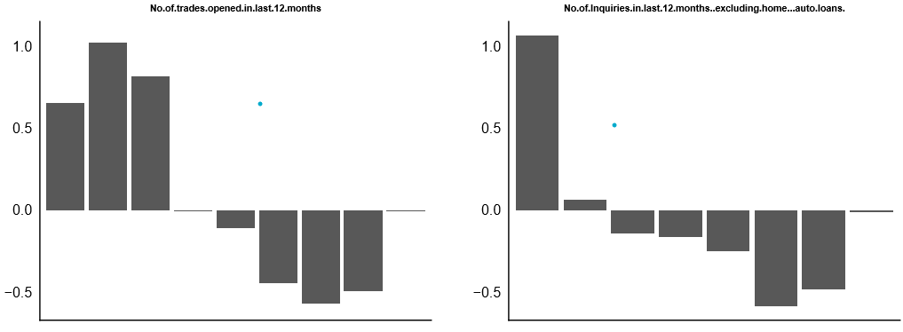
WEIGHT OF EVIDENCE(WOE)
Compute predictive power of a variable in relation to the dependent variable.
Impute missing values
Handle outliers
INFORMATION VALUE (IV)
Select and rank the most important variables in a predictive model
No variables from Demographic dataset play a significant role.
Since the below 6 variables did not monotonically change across bins from the CREDIT DATA, number of bins were reduced such that monotonic behavior is observed across bins. No.of.trades.opened.in.last.12.months,No.of.PL.trades.opened.in .last.6/12.months,No.of.Inquiries.in.last.6/12.months,Total.No.of.Trades
Eg: Non-monotonic

Slide 7
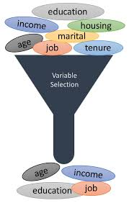
SIGNIFICANT VARIABLES FROM IV VALUES
Variable | IV
No of Inquiries.in.last.12.month -excl home,auto loan | 0.27154
Avgas.CC.Utilization.in.last.12.month | 0.26076
No.of.times.30.DPD.or.worse.in.last.6.month | 0.24156
No.of.times.90.DPD.or.worse.in.last.12.month | 0.21387
No.of.times.60.DPD.or.worse.in.last.6.month | 0.20583
No.of.times.30.DPD.or.worse.in.last.12.month | 0.19825
No.of.trades.opened.in.last.12.months | 0.19433
No.of.times.60.DPD.or.worse.in.last.12.months | 0.18543
Total.No.of.Trades | 0.18223
No.of.PL.trades.opened.in.last.12.months | 0.17664
No.of.trades.opened.in.last.6.months | 0.16977
No.of.times.90.DPD.or.worse.in.last.6.months | 0.16011

Slide 8
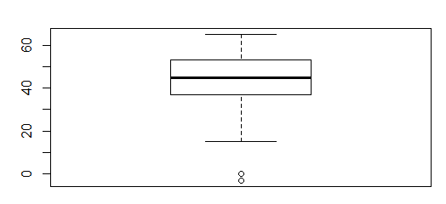
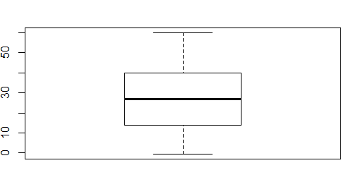
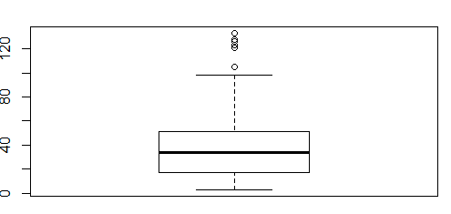
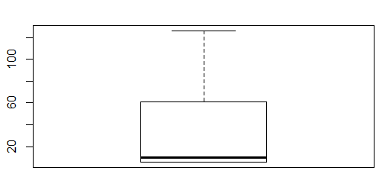
EDA-UNIVARIATE ANALYSIS
DEMOGRAPHIC DATA
45
27
Age
Income
34
10
No of Months in Current Company
No of months in current Residence
Few Outliers in Age, No of months in current Company

Slide 9
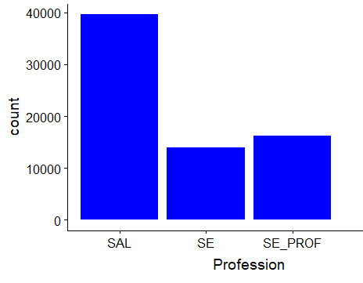
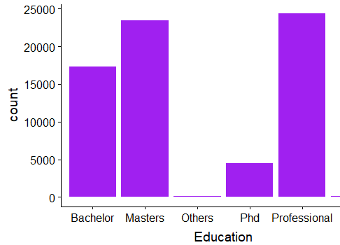
EDA-UNIVARIATE ANALYSIS
DEMOGRAPHIC DATA
Salaried Professionals apply for credit card more.
Those with professional degree apply for credit card in large numbers

Slide 10
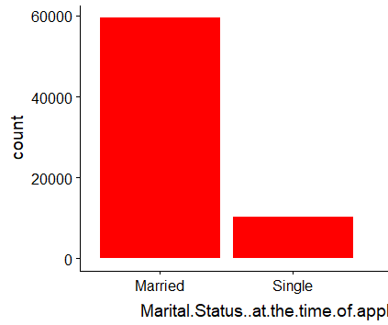
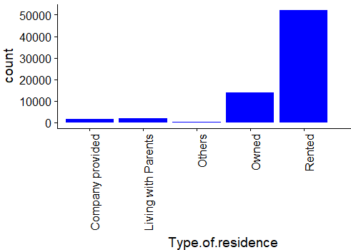
EDA-UNIVARIATE ANALYSIS
DEMOGRAPHIC DATA
Applicants who are married are higher in number
Those who are in rented accommodation tend to apply for credit cards in large numbers

Slide 11
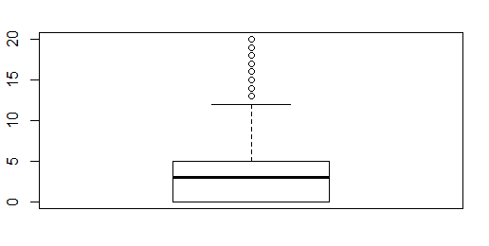
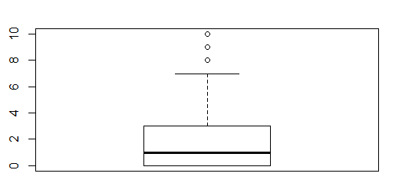
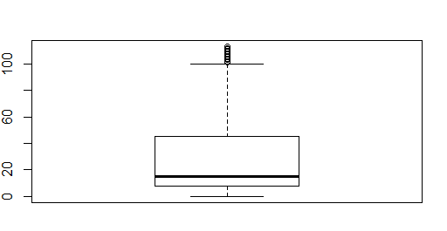
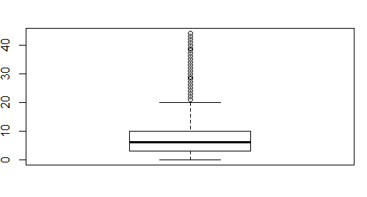
EDA-UNIVARIATE ANALYSIS
CREDIT DATA
3
1
Number of Inquiries in last 12 Months
No of Inquiries in the last 6 months
15
6
Avgas CC utilization
Total number of Trades

Slide 12
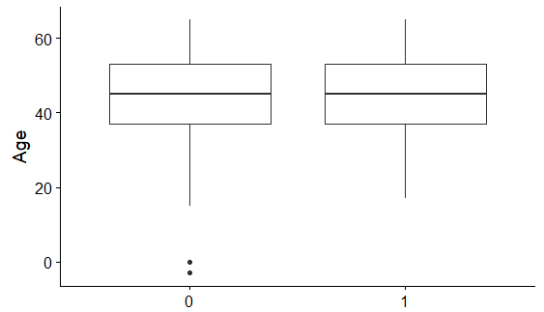
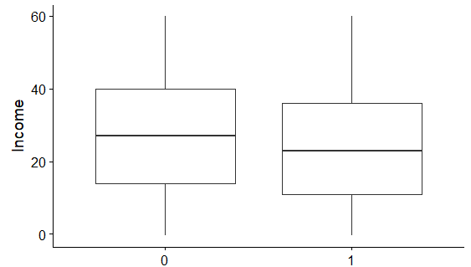
EDA-BIVARIATE ANALYSIS
DEMOGRAPHIC DATA
Age does not make a difference in default parameter
Applicants with a slightly lower income tend to default

Slide 13
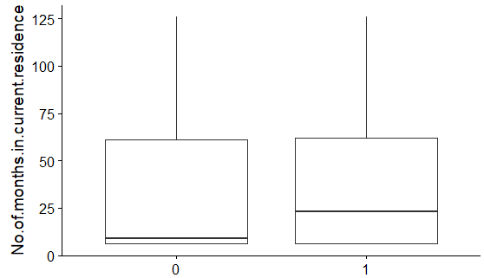
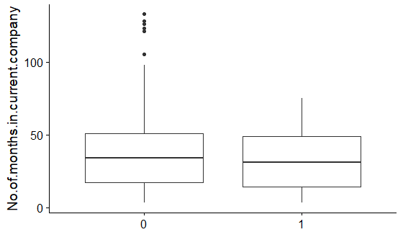
EDA-BIVARIATE ANALYSIS
DEMOGRAPHIC DATA
People with higher residence tenure default more
Tenure in a company doesn’t play a role in default rate

Slide 14
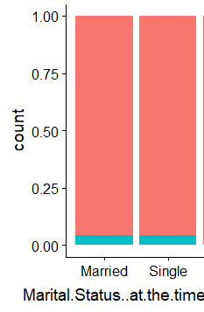
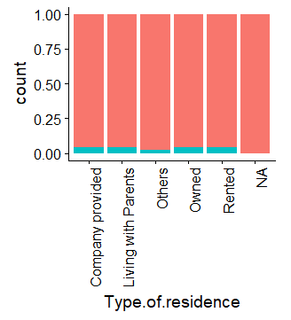
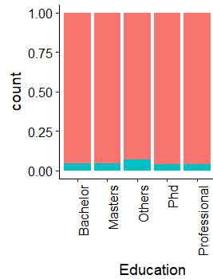
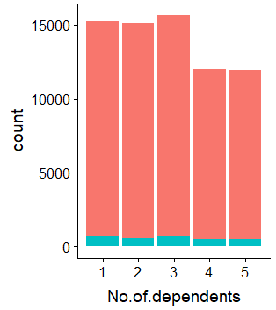
EDA-BIVARIATE ANALYSIS
DEMOGRAPHIC DATA
None of the above influence the parameter default rate

Slide 15
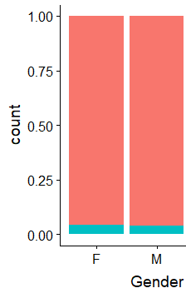
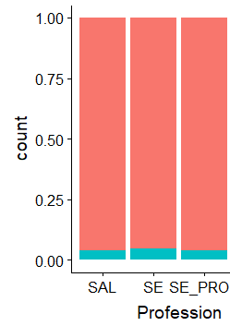
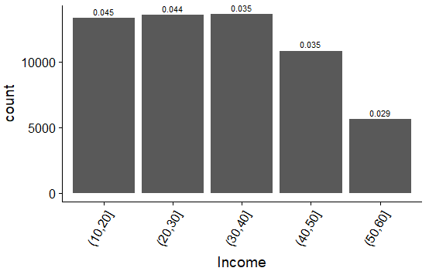
EDA-BIVARIATE ANALYSIS
DEMOGRAPHIC DATA
Both Gender and Profession does not affect default rate
Applicants for credit card reduce with the increase in income band

Slide 16
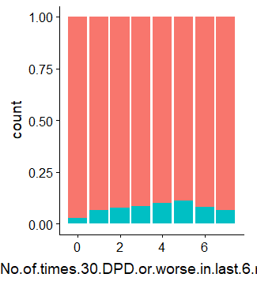
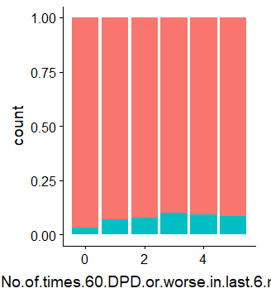
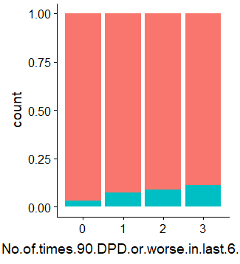
EDA-BIVARIATE ANALYSIS
CREDIT DATA
There is a similar trend observed in No of Times 30/60/90 DPD or worse in last six months and hence can be an important predictor.

Slide 17
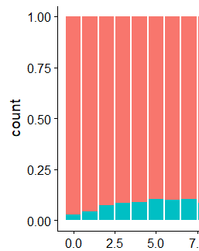
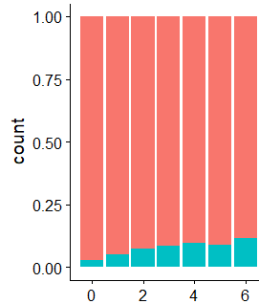
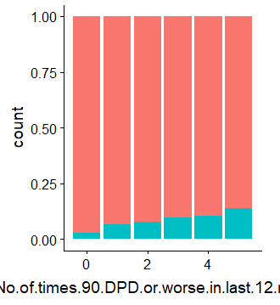
EDA-BIVARIATE ANALYSIS
CREDIT DATA
No of times 30 DPD in last 12 mon
No of times 60 DPD in last 12 mon
With increase in number of times times 30/60/90 DPD or worse in last 12 mon there is increase in default rate

Slide 18
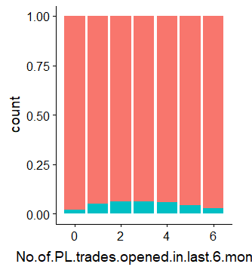
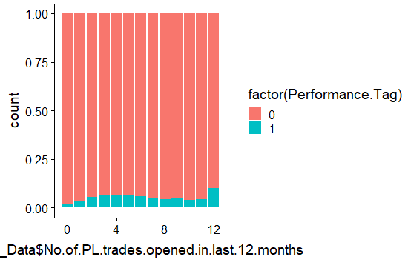
EDA-BIVARIATE ANALYSIS
CREDIT DATA
Percentage of defaulters increases with increase in number of PL trades opened in last 6 months till the 4th month and then decreases.
Percentage of defaulters is highest amongst applicants who opened 12 PL Trades in last 12 months.

Slide 19
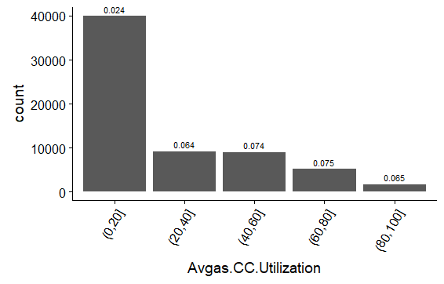
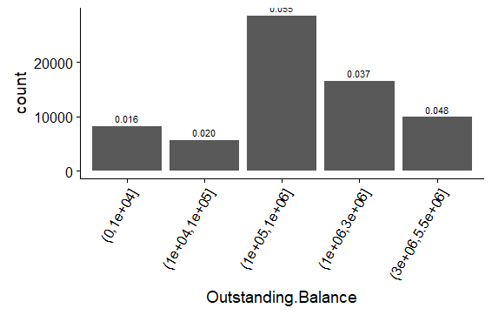
EDA-BIVARIATE ANALYSIS
CREDIT DATA
Defaulters are higher in lower credit card utilization band
Defaulters are higher in mid income band
Better insights could be obtained from CREDIT DATA in comparison with DEMOGRAPHIC DATA

Slide 20
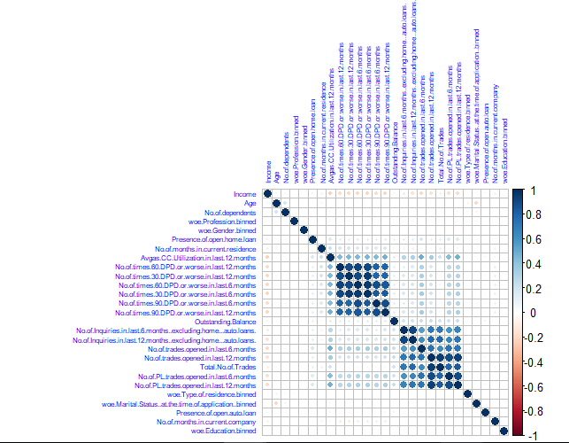
CORRELATION PLOT ON MERGED DATA
Data merged using “Application ID” as common field for join
2 Groups of data having positive correlation with each other..
No.of.times.90.DPD.or.worse.in.last.6.months
No.of.times.60.DPD.or.worse.in.last.6.months No.of.times.30.DPD.or.worse.in.last.6.months No.of.times.90.DPD.or.worse.in.last.12.months No.of.times.30.DPD.or.worse.in.last.12.months No.of.times.60.DPD.or.worse.in.last.12.months Avgas.CC.Utilization.in.last.12.month
No.of.trades.opened.in.last.6.months No.of.PL.trades.opened.in.last.6.mon No.of.PL.trades.opened.in.last.12.mon No.of.trades.opened.in.last.12.months
Total.No.of Trades
No.of.Inquiries.in.last.12.mon
No.of.Inquiries.in.last.6.months

Slide 21
MODEL BUILDING DEMOGRAPHIC DATA
OUTLIER TREATMENT: Outlier detection is done using boxplot on continuous variables and quantiles function and the variables
with outliers has been corrected by capping the outliers to the nearest non-outlier values.
DATA SCALING: Scaling is performed for all variables except Application ID and performance tag to standardize the data into common scale.
DATA SPLIT: The final dataset is split into Train and Test in 70:30 ratio for model building.
All models are trained on training datasets and regularization
was done by tuning of hyper parameters with cross validation
on validation datasets.
All the models are tested on test datasets that were kept
separate from training and validation datasets.
DATA SAMPLING: The given data is highly imbalanced. We have sampled data using ROSE package for balancing the training data sets.
The cutoff value for the probability of default was chosen such that model evaluation metrics like accuracy ,sensitivity and specificity were almost equal to each other.
Logistic Regression was built by iteratively removing using these two algorithms
1. Stepwise variable selection based on AIC[using stepAIC()]
2. Backward variable selection based on VIF and p value

Slide 22
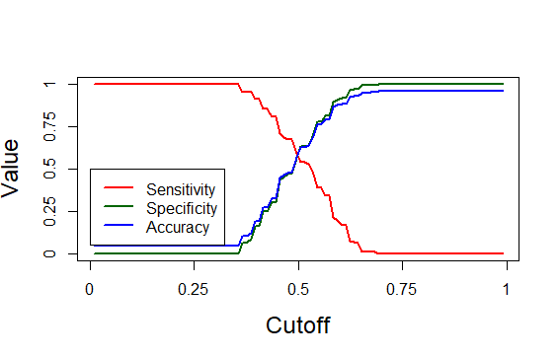
LOGISTIC REGRESSION-DEMOGRAPHIC DATA
Important Predictors:
WOE.No of months in current residence Binned
WOE No of months in current company binned
WOE Income Binned
Statistics | Values
Cut-off | 0.495
Accuracy | 57%
Sensitivity | 59%
Specificity | 57%
Thus a logistic regression model based only on demographic data seems to have low performance. Hence lets build a model with both demographic and credit data merged.

Slide 23
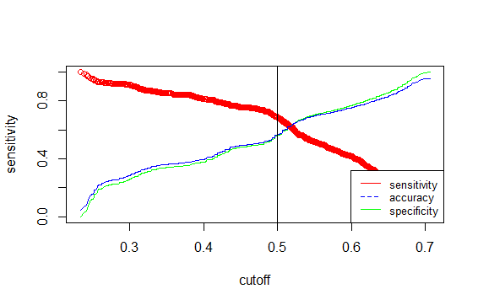
LOGISTIC REGRESSION-MERGED DATA
Important Predictors:
Income
No of Months in current company
No of times 90 DPD or worse in last 12 months
No of times 60 DPD or worse in last 12 months
No of times 30 DPD or worse in last 12 months
Avg CC Untilization in last 12 months
No of trades opened in last 6 months
No of PL trades opened in last 12 months
No of Inquiries in last 12 months exl home and auto loans
Statistics | Values
Cut-off | 0.519
Accuracy
Sensitivity
Specificity

